Slide 1
Topic: Evolution and OB Models
Dr. C. Vijaya Banu
Associate Professor , School of Management
SASTRA Deemed University, Thanjavur – 613 401
vijayabanu@mba.sastra.edu

Slide 2
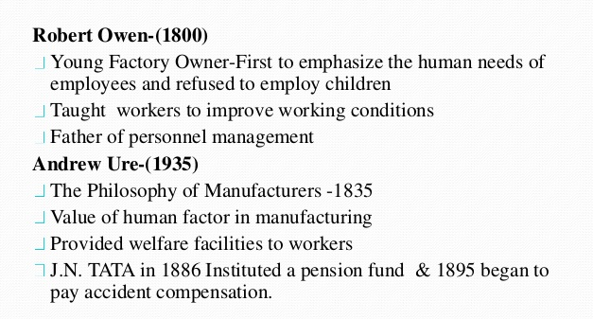
Evolution of OB

Slide 3
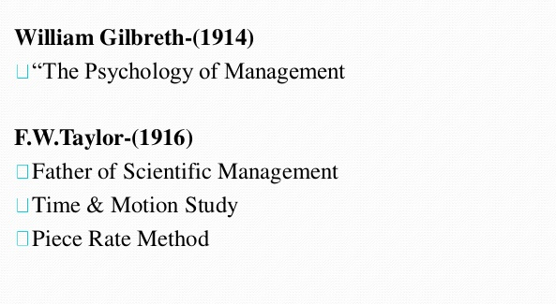
Evolution of OB

Slide 4
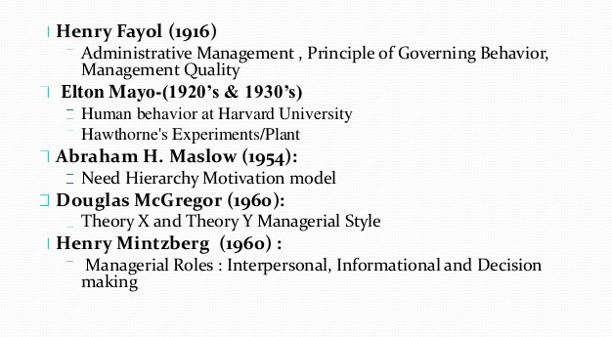
Evolution of OB

Slide 5
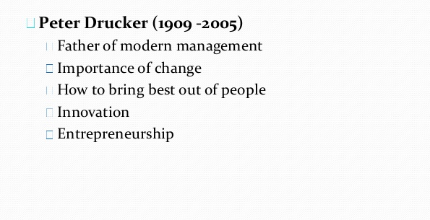
Evolution of OB

Slide 6
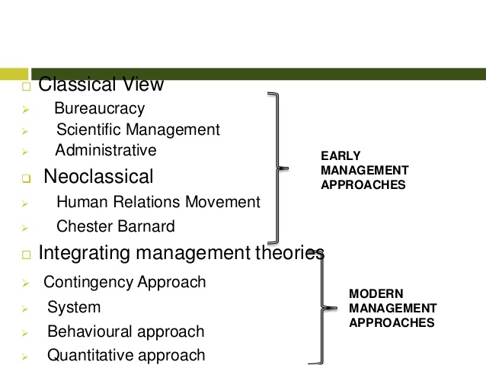
Historical Evolution of OB

Slide 7
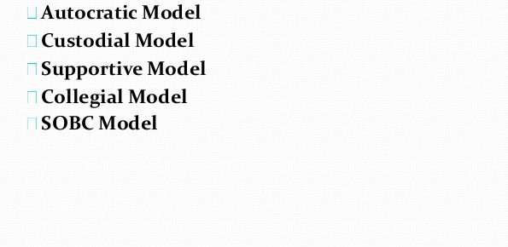
Models of OB

Slide 8
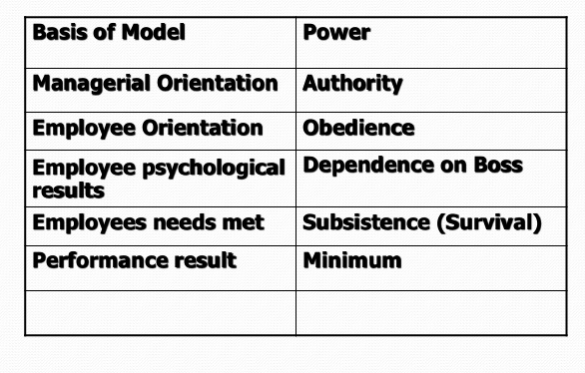
Autocratic Model

Slide 9
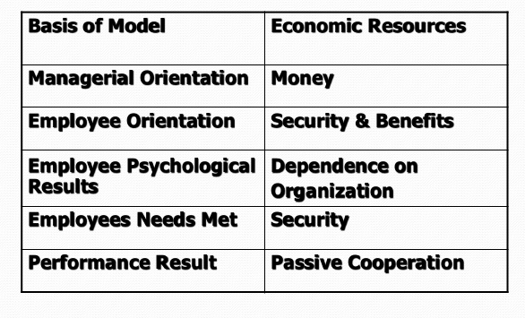
Custodian Model

Slide 10
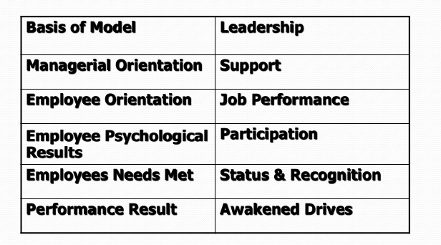
Supportive Model

Slide 11
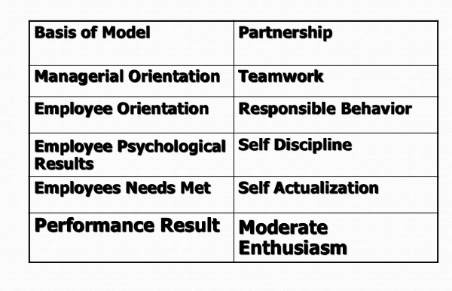
Collegial Model

Slide 12
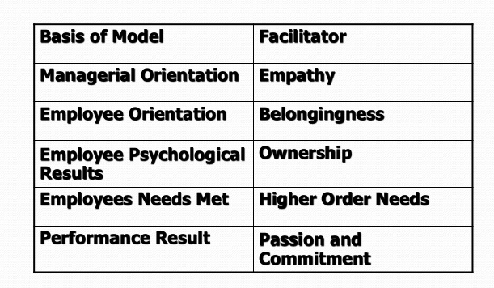
SOBC Model

Slide 13
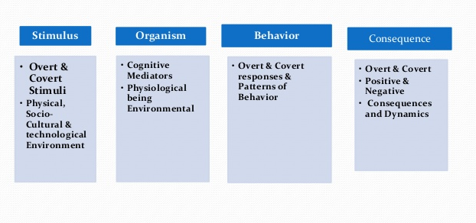
SOBC Model

Slide 14
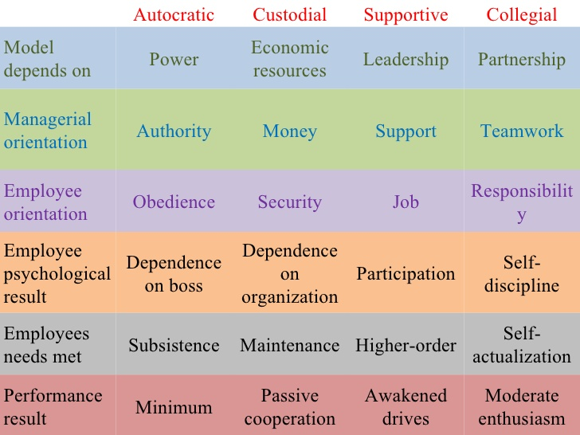
OB Models

Slide 15
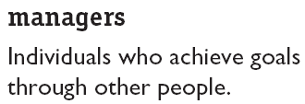
What Managers Do
Managerial Activities
Make decisions
Allocate resources
Direct activities of others to attain goals
© 2003 Prentice Hall Inc. All rights reserved

Slide 16
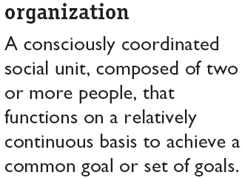
Where Managers Work

Slide 17
Management Functions
Planning
Organizing
Management Functions
Controlling
Leading

Slide 18
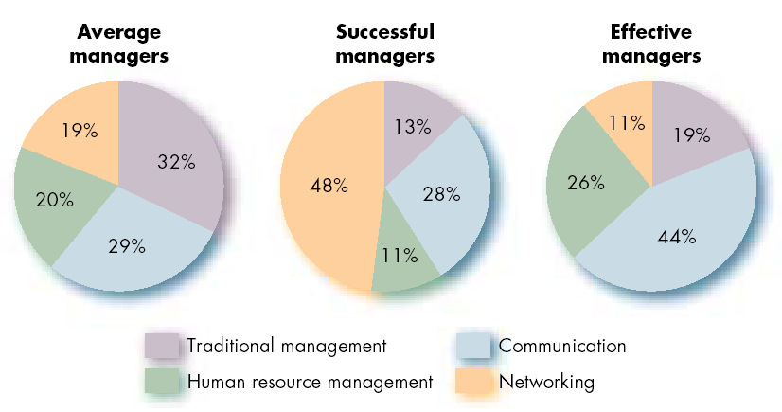
Allocation of Activities by Time

Slide 19
Three Good Reasons Why You Should Care About . . . Organizational Behavior
Understanding the dynamics of behavior in organizations is essential to achieving personal success as a manager, regardless of your area of specialization
Principles of organizational behavior are involved in making people both productive and happy on their jobs
To achieve success in today’s rapidly changing environment, organizations must successfully address a wide variety of OB issues
Notes:
2

Slide 20
Challenges and Opportunities for OB
Responding to Globalization
Increased foreign assignments
Working with people from different cultures
Coping with anti-capitalism backlash
Overseeing movement of jobs to countries with low-cost labor
Outsourcing/ in-sourcing, off-shoring, multi-sourcing, open-sourcing, BPO, Call centers
Managing Workforce Diversity
Embracing diversity
Changing demographics of countries
Implications for managers
Recognizing and responding to differences

Slide 21
Challenges and Opportunities for OB (cont’d)
Improving Quality and Productivity
Quality management (QM)
Process reengineering
Responding to the Labor Shortage
Changing work force demographics
Fewer skilled laborers
Early retirements and older workers
Improving Customer Service
Increased expectation of service quality
Customer-responsive cultures

Slide 22
Improving Quality and Productivity
Quality management (QM)
The constant attainment of customer satisfaction through the continuous improvement of all organizational processes.Requires employees to rethink what they do and become more involved in workplace decisions.
Process reengineering
Asks managers to reconsider how work would be done and their organization structured if they were starting over.Instead of making incremental changes in processes, reengineering involves evaluating every process in terms of its contribution.

Slide 23
Challenges and Opportunity for OB (cont’d)
Improving People Skills
Empowering People
Stimulating Innovation and Change
Coping with “Temporariness”
Working in Networked Organizations
Helping Employees Balance Work/Life Conflicts
Improving Ethical Behavior

Slide 24


